Slide 1

E-Project RainWater Harvesting
Group D
Student Name
ZuBAIR AHMED MAMOON SHER
YASIR KHAN
ALWAZ KASHIF

Slide 2
PROBLEM STATEMENT :
Rainwater harvesting is a technique used for collecting, storing and using rainwater
for landscape irrigation and other uses. The rainwater is collected from various hard
surfaces such as rooftops and/or other manmade aboveground hard surfaces. For a
dry climate , rainwater harvesting can make a huge beneficial impact on the
environment.
Most rural households have to source all their water on their property, and rainwater
often provides a better quality household supply than river, bore or dam water.
Rainwater harvesting is not just for rural areas though. Although urban households
may be connected to a reticulated, treated (mains) water supply, rainwater
harvesting can significantly lower mains water usage.
What are the benefits of rainwater harvesting? It will reduce water bills, provide an
alternative supply during water restrictions and help maintain a green, healthy
garden. In fact, depending upon tank size and climate, rainwater harvesting can
reduce mains water use by 100%. Rainwater harvesting also decreases storm water
runoff, thereby helping to reduce local flooding and scouring of creeks.
We are here looking at a website which will provide brief details about few facts and
details about rainwater harvesting
The website is supposed to provide user friendly environment and navigation. The
important menu must be stated in the top section of the webpage. Also a decent look
out and color combination is expected.
The website is to be developed for the Windows Platform using HTML5, JavaScript
and Geolocation. The site should work well in all leading browsers including Chrome,
IE, Firefox etc.

Slide 3
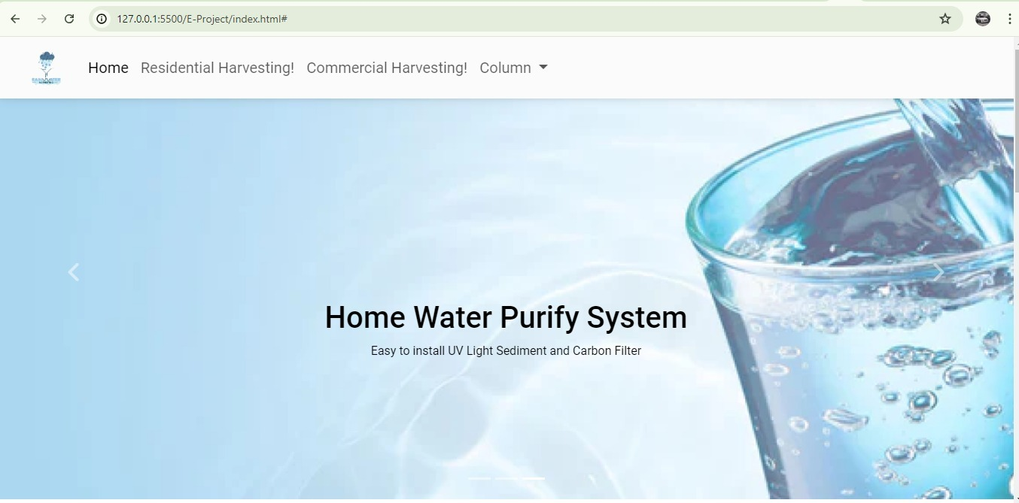
HOME PAGE :

Slide 4
AGE :

Slide 5
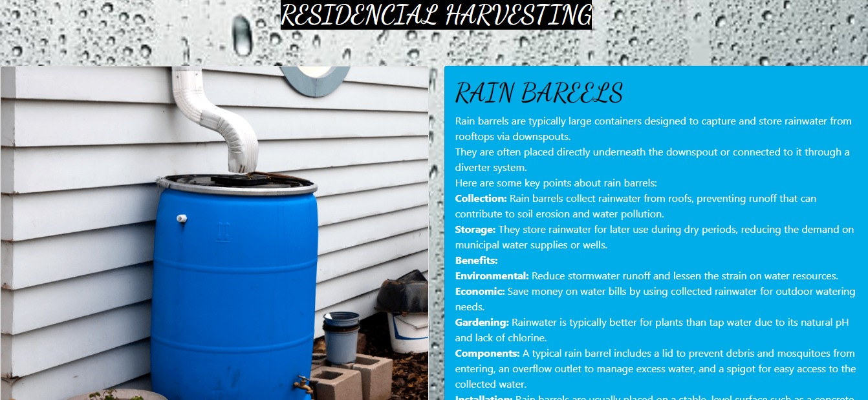
HOME PAGE :

Slide 6
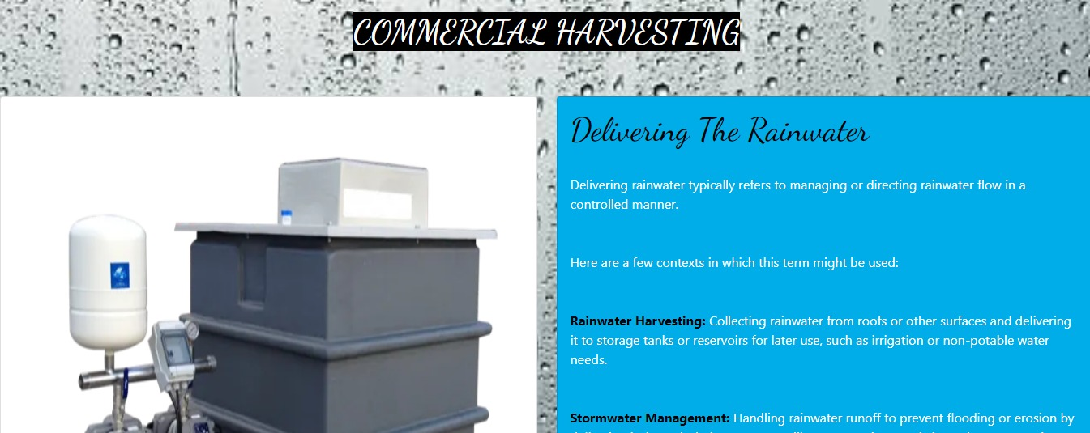
HOME PAGE :

Slide 7
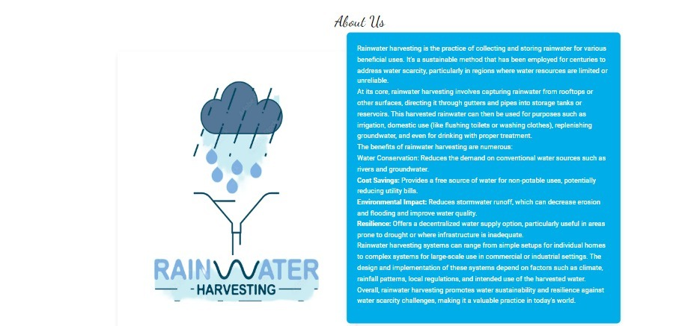
About US PAGE :AB

Slide 8

HOME PFOOTER : :

Slide 9
THANK YOU
TO VISITING OUR WEBSITE :

